Slide 1
UNCERTAINTY ANALYSIS
in SURFACE WATER HYDROLOGY
Abhirama Gorti 20AG38002

Slide 2
TABLE OF CONTENTS
01
02
03
04
05
06
Introduction
Hydrological Models
Moldes and their Impact
Uncertainty Analysis Methods
CHALLENGES
Conclusion and Sources

Slide 3
01
INTRODUCTION

Slide 4
INTRODUCTION TO UNCERTAINTY
All the natural phenomena around us are subject to some degree of uncertainty. Hydrology is no exception. The study of uncertainty analysis in hydrology is crucial to understanding the limitations of our models and predictions.
Uncertainty is a lack of knowledge or information about a particular event. In our context, this can arise from various sources of measurement errors, model structure, and parameter estimation. Uncertainty can be classified broadly into two types.
Epistemic Uncertainty
Aleatory Uncertainty

Slide 5
INTRODUCTION TO UNCERTAINTY
Epistemic Uncertainty
Aleatory Uncertainty
This uncertainty occurs due to the lack of information about the system, which is not purely random. Any probability distribution cannot represent it.
This irreducible part of total uncertainty occurs due to chaos inherent in natural processes. A probability distribution can characterize them.

Slide 6
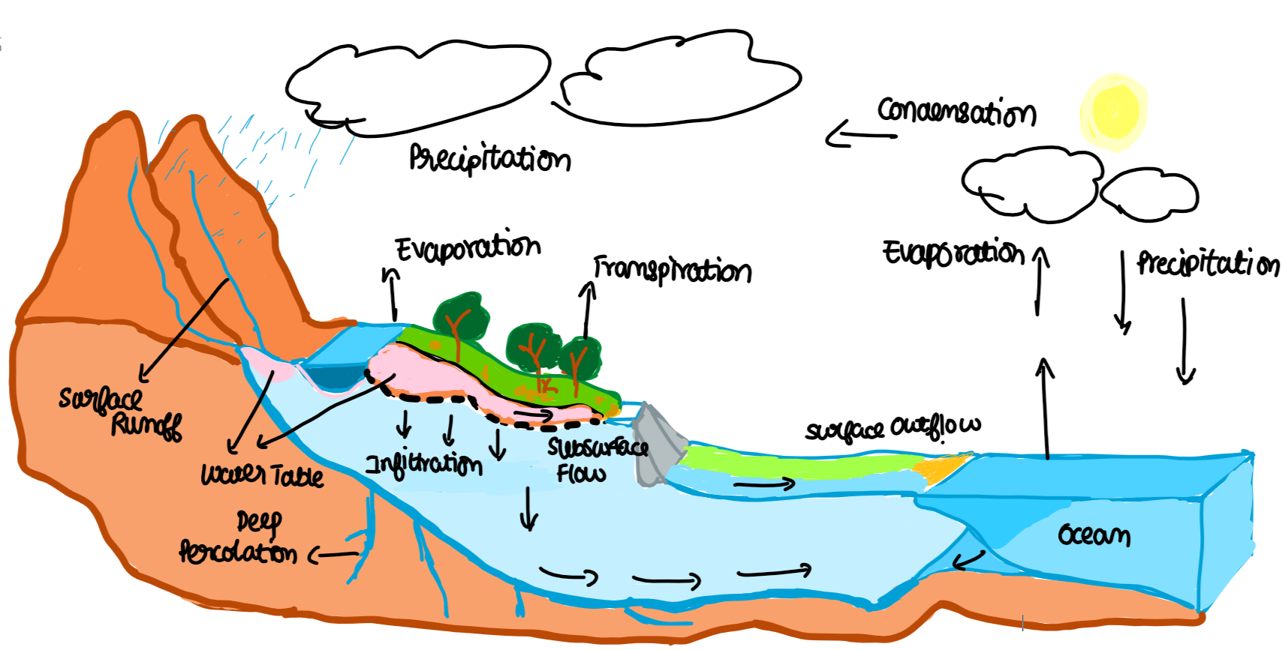

Slide 7
TYPES OF EPISTEMIC UNCERTAINTIES
MODEL STRUCTURE
PARAMETER
INPUT DATA
This is one of the most impacting uncertainty components, representing the mathematical structure used to map the target variable.
Understanding Parameter uncertainty can help us identify which parameters impact model predictions more and can help in data collection efforts.
It is the uncertainty introduced by the decisions to select data and transform them using various equations.

Slide 8
INTRODUCTION TO UNCERTAINTY
An accurate representation of a model is complex because of the complexity of natural systems. Hence, we assume the consistency of variables that are hard to measure. This gives rise to Structural Uncertainty. Structural uncertainty is one of the most significant contributors to uncertainty in hydrology, followed by input data uncertainty.
Data points for predicting a target variable are collected using various measurement techniques, but it is difficult to get data accurately for every point on a catchment. Approximations and Interpolations between measuring sites lead to the input data uncertainty.
We select the appropriate parameter space based on whether the catchment is gauged or ungauged. From the Equifinality hypothesis, multiple ways (parameter sets) exist to arrive at a target value. This creates uncertainty in the extent of tuning parameters on calibrated data.
Aleatory / Stochastic Uncertainty is addressed less in this presentation than in others because it deals less with hydrology and is more related to Probability and Information Theory.

Slide 9
02
HYDROLOGICAL MODELS

Slide 10
HYDROLOGICAL MODELS
HYDROLOGICAL MODELS
Hydrological models can be defined as simplified versions of complex systems that help us in the decision-making process. They are constituted by mathematical equations, logical statements, and initial and boundary conditions expressing the relations between input, variables and parameters.
They can be segmented based on the type of simulation, spatial representation and solution method.

Slide 11
HYDROLOGICAL MODELS
SIMULATION BASIS CLASSIFICATION
Empirical Models
Conceptual Models
Physically Based Models
Empirical models are a type of hydrological model that is based on input-output relationships rather than physical principles.
They are generally limited due to a lack of understanding of the governing processes and an inability to assess initial conditions.
These are precipitation-runoff models built based on empirical relationships among different hydrological variables.
They represent the hydrological processes involved in converting precipitation to runoff over land and streamflow discharge at the basin outlet.
The models are based on solving differential equations describing physical laws, such as energy and mass conservation.
The terrain/watershed is divided into cells of small spatial resolution, and hydrological processes are calculated at that scale.

Slide 12
HYDROLOGICAL MODELS
SPATIAL AREA CLASSIFICATION
Distributed Models
Lumped Model
These consider the spatial variability of the hydrological processes across a catchment. We divide the catchment into smaller sub-catchments and simulate the hydrological processes individually.
They might have multiple outputs based on the processes involved in model formulation
Treat the catchment as a single unit, with state variables representing averages over the catchment area average storage in the saturated zone.
They are formulated using a relatively small number of components. Parameters are calibrated using trial error/automatic optimization techniques.

Slide 13
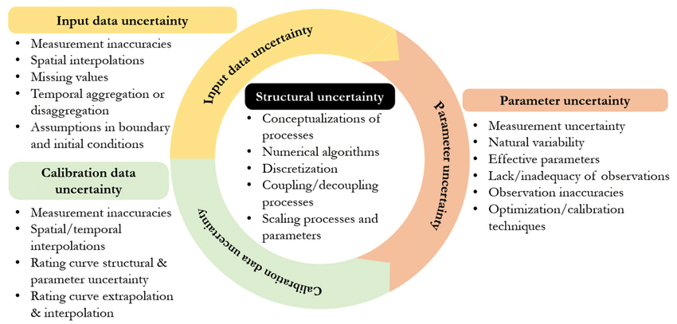

Slide 14
03
MODELS AND THEIR IMPACT

Slide 15
Models and their Impact
Keith Beven (Beven, Binley et al. 1991):
Keith Beven's influential paper discusses the Equifinality Theory, challenging the traditional scientific approach by emphasizing that multiple acceptable models can fit observational data.
Brirhet and Benaabidate (2016):
Brirhet and Benaabidate compare the adaptability of distributed and lumped hydrological models in the Moroccan context, concluding that distributed models tend to provide more accurate predictions in specific contexts.
Orth et al. (2015):
Orth et al. validate and compare three hydrological models of different complexities, highlighting that the relationship between model complexity and performance depends on specific hydrological conditions and calibration uncertainties.
These papers discuss the challenges of mapping model parameters and explore methods for parameter estimation and uncertainty analysis in hydrological modelling.

Slide 16
04
UNCERTAINTY ANALYSIS METHODS

Slide 17
Uncertainty Analysis Methods
MONTE CARLO ANALYSIS AND GLUE
BAYESIAN STATISTIC
MULTI OBJECTIVE ANALYSIS
LEAST SQUARE BASED INVERSE MODELING
RESPONSE SURFACE BASED TECHNIQUES
MULTI MODELING ANALYSIS

Slide 18
05
CHALLENGES AND CONCLUSION

Slide 19
CHALLENGES
MODEL IMPERFECTION
DATA AGGREGATION
COMPLEX DYNAMICS
Leads to uncertainty in a long term future projection
Bias correction and drift removal can used to reduce the impact
Failure of demand prediction models
Managing prediction uncertainty presents significant challenges in environments characterized by complex dynamics.

Slide 20
REFERENCES USED
Adrian E. Raftery, D. M. and Hoeting, J. A. (1997). Bayesian model averaging for linear regression models. Journal of the American Statistical Association, 92(437):179–191. Amanambu, A. C., Mossa, J., and Chen, Y.-H. (2022). Hydrological drought forecasting using a deep transformer model. Water, 14(22). Beven, K. and Binley, A. (1992). The future of distributed models: Model calibration and uncertainty prediction. Hydrological Processes, 6(3):279–298. Binley, A., Beven, K., Calver, A., and Watts, L. (1991). Changing responses in hydrol- ogy: Assessing the uncertainty in physically based model predictions. Water Resources Research - WATER RESOUR RES, 27:1253–1261. Brirhet, H. and Benaabidate, L. (2016). Comparison of two hydrological models (lumped and distributed) over a pilot area of the issen watershed in the souss basin, morocco. European Scientific Journal, ESJ, 12(18):347.

Slide 21
THANKS!

